Slide 1



Agenda
Research Problem
Current Recommendations
Proposed Solution
Research Aim
Research Results
Next Steps

Slide 2
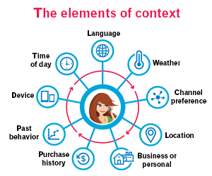

Research Problem
Most software systems operate within a complex and variable context.
Challenge: ensure that requirements keep pace with the changing context.

Slide 3
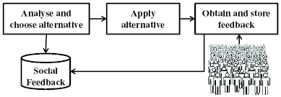


Research Recommendations
Continuous Users’ feedback of software at runtime is a powerful tool
Benefits: it enables the capturing and communication of a richer and updated knowledge on how users view the software.

Slide 4
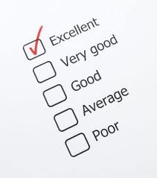

Acquiring Users’ Input
Requirements are gathered from a diverse groups of users.
Requirements are volatile in nature.
Challenge: or users provide their feedback on the fulfilment of requirements either in a natural language and an ad-hoc manner
Challenge: users provide their feedback on the fulfilment of requirements in a very restrictive manner such as ranking

Slide 5

Feedback Analysis
A range of semi-automated techniques have been suggested to handle such user data
Benefits: These techniques may be used to gather, interpret, aggregate, and revise what users say
Challenges: issues such as bias and subjectivity

Slide 6
Proposed Solution
Arguably, more effective results can be reached if the feedback is written in a structured format.
Benefits:
Allow approaches, such as text processing, to provide more accurate results.
Less time and with fewer human interventions.
The requirements extraction process can be more systematic and reliable.
Eliminating complexity and ambiguity found in natural language, and requiring less effort.
Support engineers in taking evolution and maintenance decisions.

Slide 7

Focus Group Study
Two Session Focus Groups
A total of 15 volunteers, 8 males and 7 females
Aged between 18 and 40
Participants mainly came from Egypt and UK with various backgrounds
The sessions lasted 2 hours and 52 minutes.
Both sessions were audio recorded and transcribed with consent from participants.

Slide 8

Focus Group Study
The main areas we wanted to explore were:
How users would like feedback to look like, and the criteria that judge whether the feedback is meaningful and useful?
How users would like to be involved in the process of providing feedback, and what encourages them to act as evaluators?

Slide 9
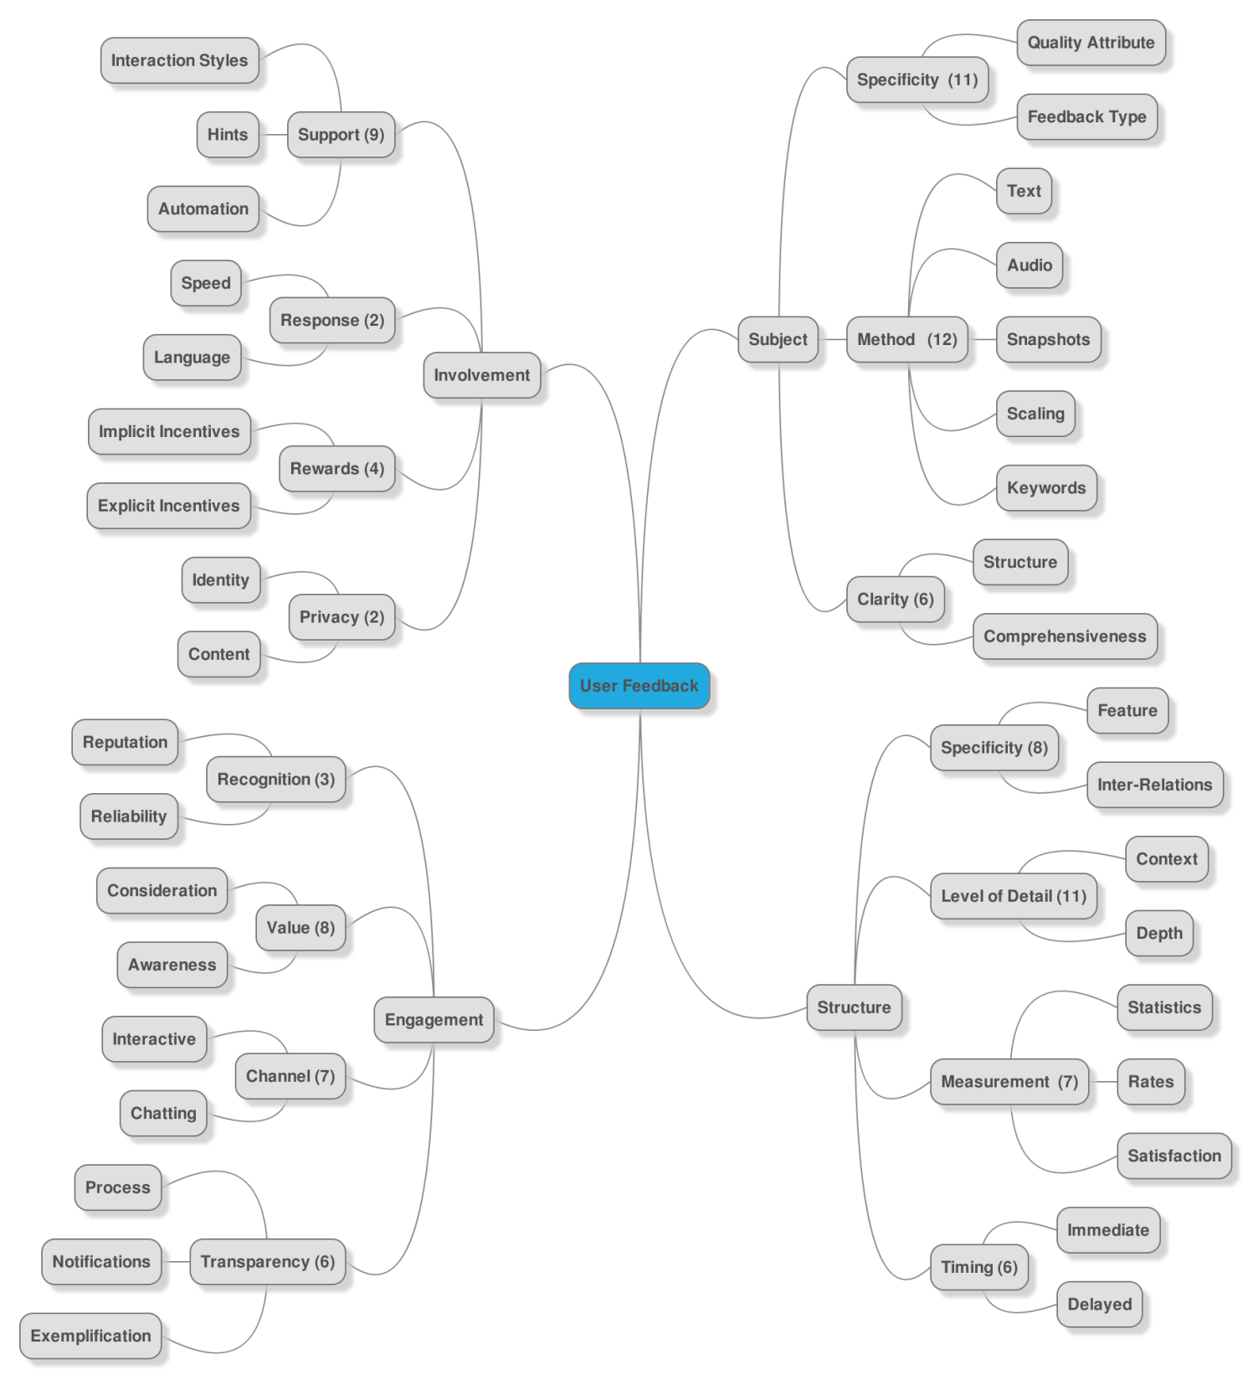

Slide 10




Online Forums Study
We have analysed 200 feedbacks from 20 different sources.
We targeted enterprise software to avoid the noise typically found in general purpose software.
Business users are best fitted from the motivation perspective.
We have chosen these three forums in order to target different types of business users with diverse technical capabilities.

Slide 11
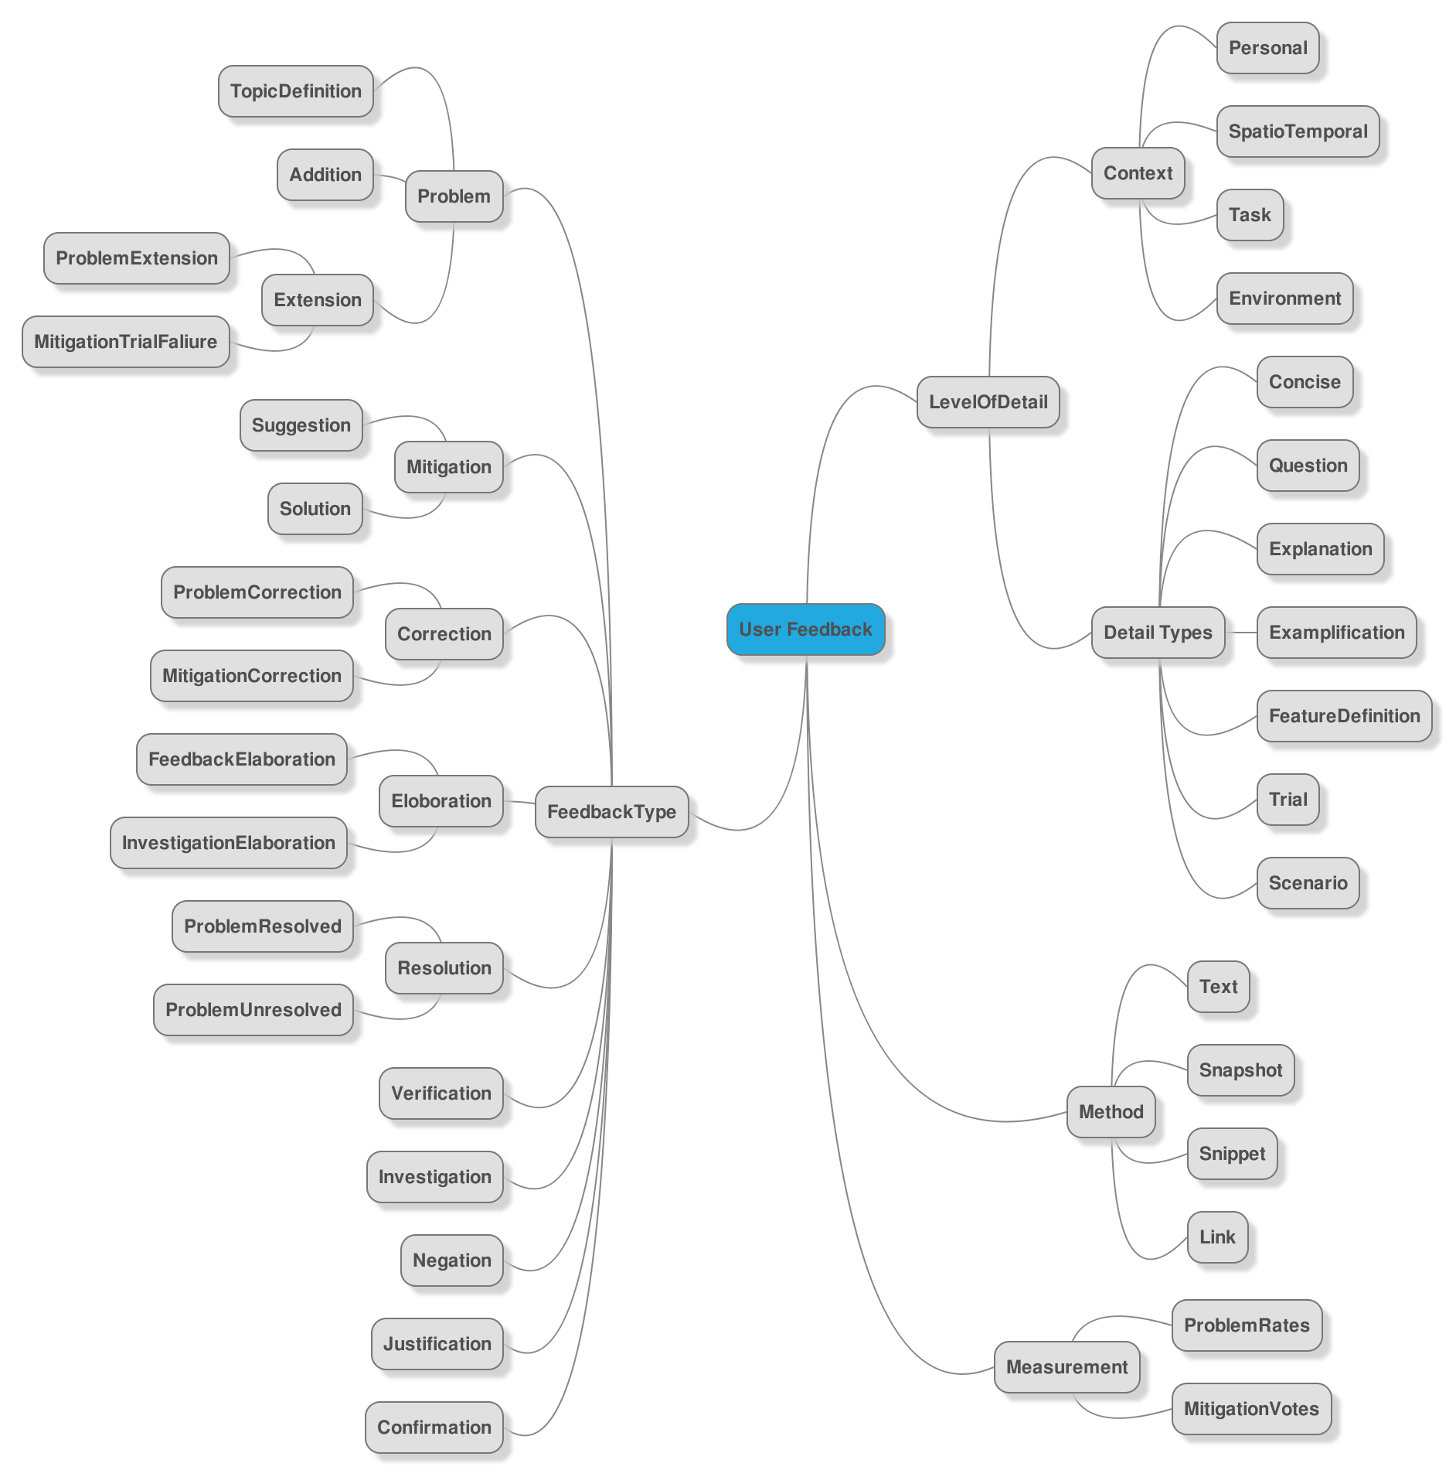

Slide 12
Ontologies
Our objective is to build ontology of feedback concepts
Benefits:
It includes machine-interpretable definitions of basic concepts in the domain and relationships among them.
It defines a common vocabulary for researchers who need to share information in a domain.
It can be easily extended and maintained.
To enable reuse of domain knowledge

Slide 13
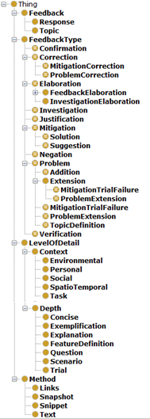
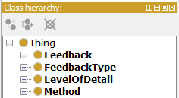
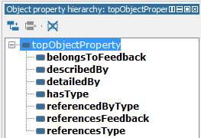
Class Hierarchy
Object Property Hierarchy

Slide 14
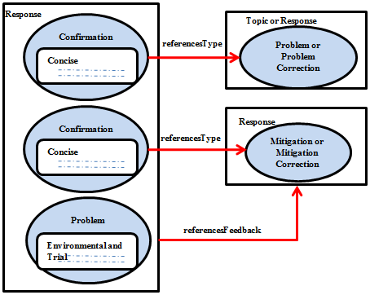
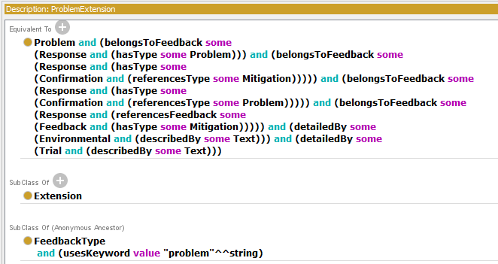
Feedback Structure Ontology Rules
Ontology Design

Slide 15
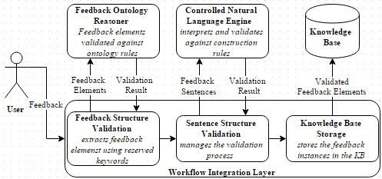
Socio-technical Architecture for Feedback Acquisition

Slide 16
Novel Users’ Feedback-Based Evaluation Templates for Supporting Software Maintenance and Evolution

Slide 17
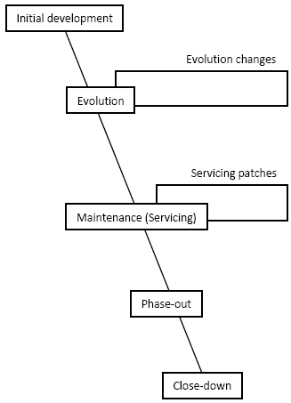
Staged Model of Software Lifespan

Slide 18
Purpose of the Study
The purpose of the study is to gather information about the problems that face the software engineers during the maintenance and evolution.
Maintenance/ Evolution is initiated by change requests triggered by customers.
Our study focuses on the problems caused by the miscommunication between both engineers and customers in the initial stages.

Slide 19
Study Themes
Initiation phase deals with requirements: their elicitation, analysis, prioritization, and so forth.
The next phase is concept location & change propagation that finds the module or code snippet that must be changed in order to implement the change request.
Once the location of the change is found, impact analysis determines the strategy and the full extent of the change.
Then we will analyze problems related to release planning.

Slide 20
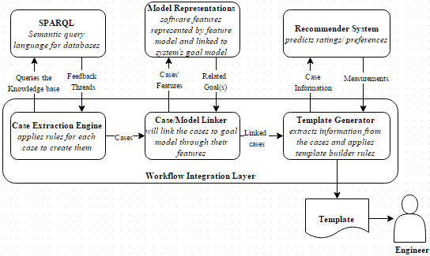
Architecture for Generating Evaluation Templates

Slide 21
Interview Sessions
Different Roles
10 Interviews
Participants Consent
Tuesday 19 Jan 2016 & Thursday 21 Jan 2016

Slide 22

Thank You Questions

